Slide 1
27 Jun 2024

Slide 2
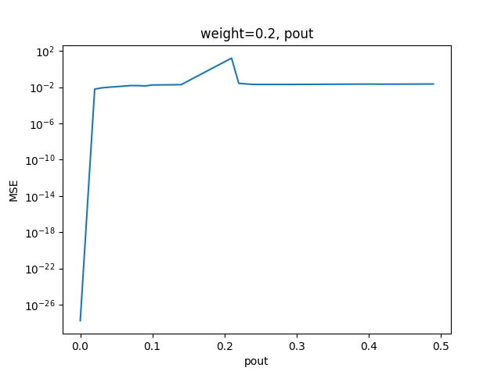
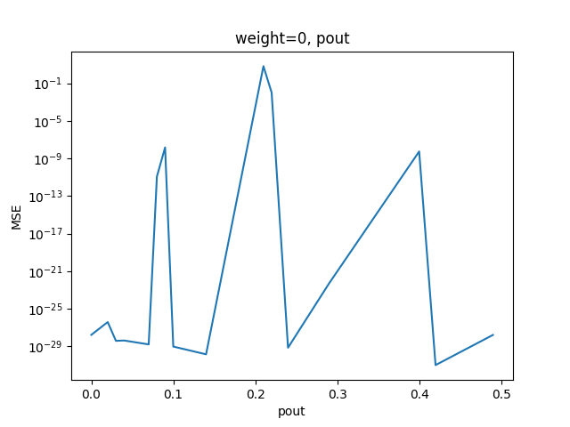
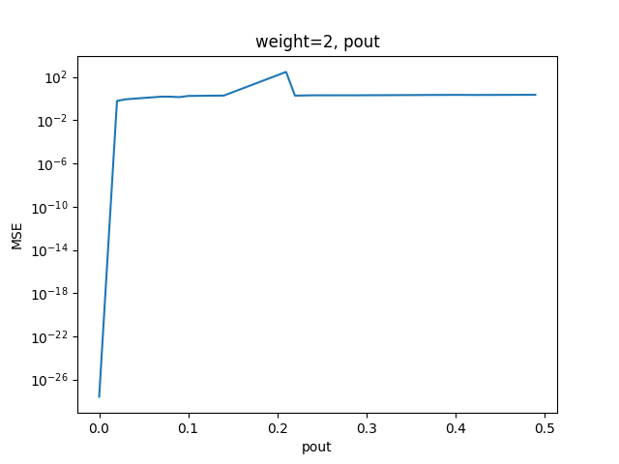
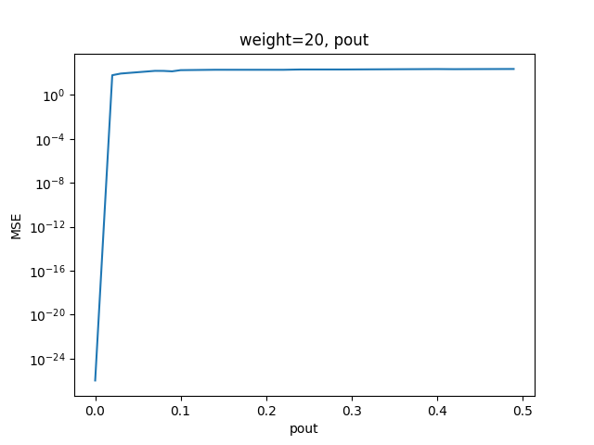
Consensus + Innovation Algorithm, pout
10^(-2) level
10^(-1) level
10^2 level
Divergent region

Slide 3
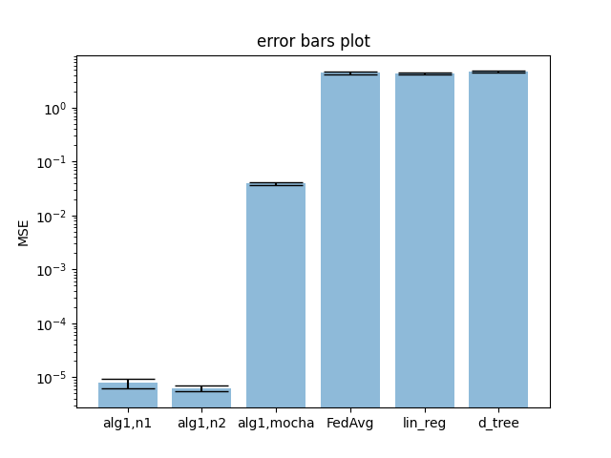
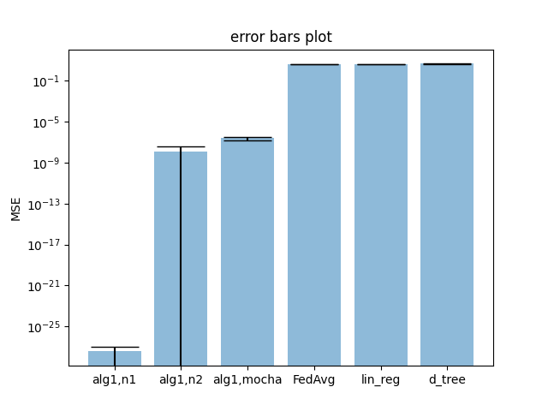
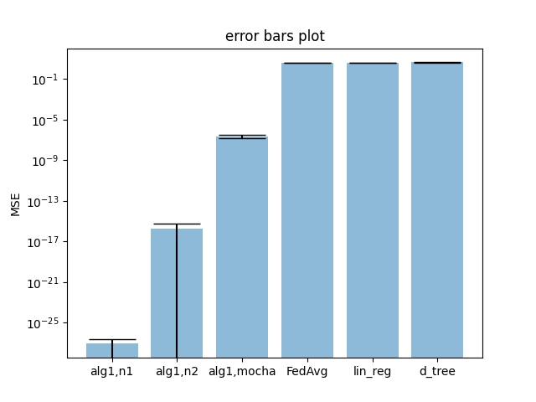
Other Algorithms, pout
pout=0.01
pout=0.0001
pout=0

Slide 4
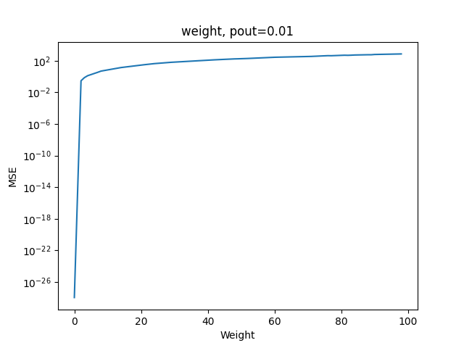
Consensus + Innovation Algorithm, Weight

Slide 5
Observation
Keep constant weight:
MSE decreases with reducing communication probability between blocks
Keep constant pout:
MSE decreases with reducing weight

Slide 6
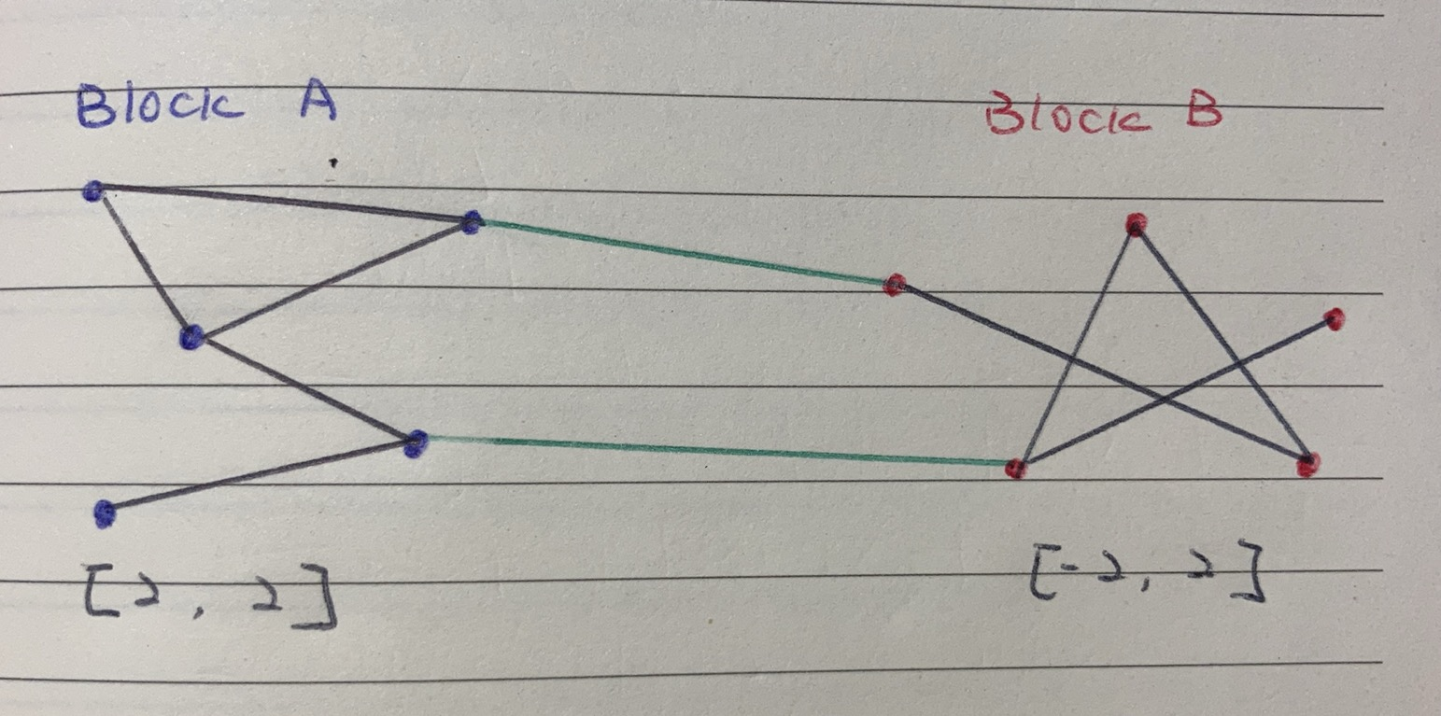
Visualization – Whole Graph

Slide 7
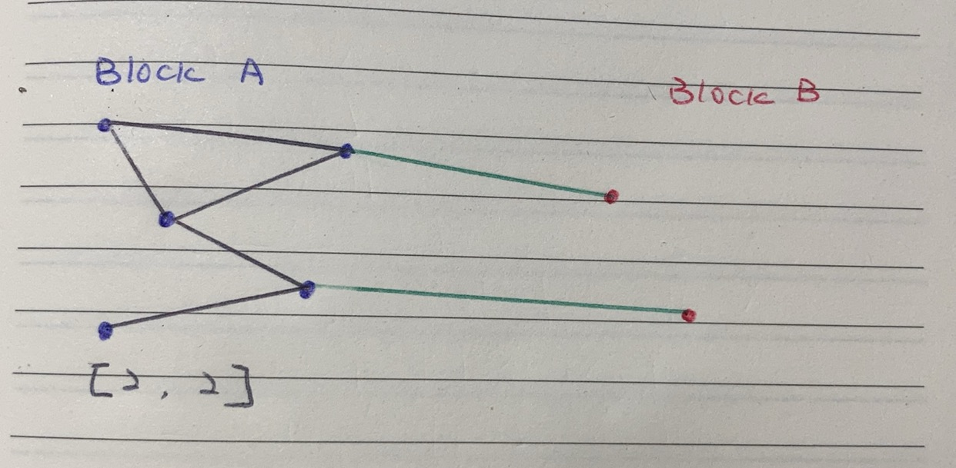
Visualization – Block A

Slide 8
Visualization – Block A
Unassigned weights but assume to be [2, 2] in this case
Errors occur
Generated by [-2, 2]

Slide 9
Explanation
Difference between weight | MSE | Correlation between blocks | Homogeneity | Effect of communication between blocks
Smaller | Lower | Higher | Higher | Kind of useful
Larger | Higher | Lower | Lower | Harmful
pout | MSE | # of edges between blocks | # of homogeneous agents | Effect of communication between blocks
Lower | Lower | Less | Less | Less harmful
Larger | Higher | More | More | More harmful

